Slide 1
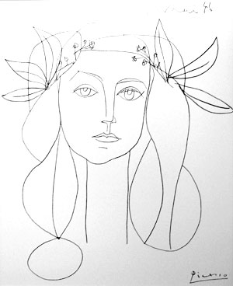
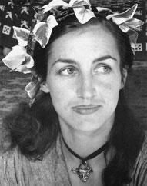
Image Features Class 2
Picasso, 1946
Francoise Gilot

Slide 2
Today
Canny Edge detector
Point Features
Harris corner detector
Feature Descriptors
Matching
Evaluation

Slide 3
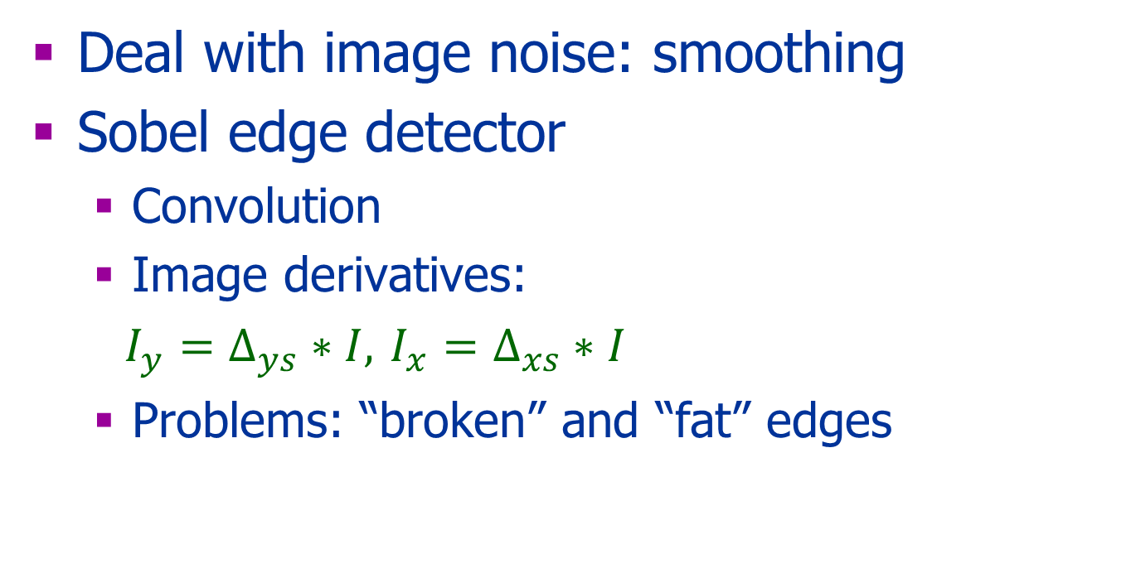
Last Class
Deal with image noise: smoothing
Sobel edge detector
Convolution
Image derivatives:
$I_{y}=Δ_{ys}∗I,$ $I_{x}=Δ_{xs}∗I$
Problems: “broken” and “fat” edges

Slide 4
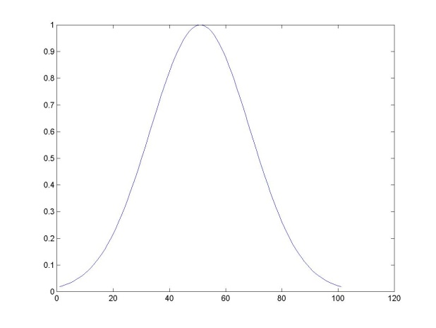
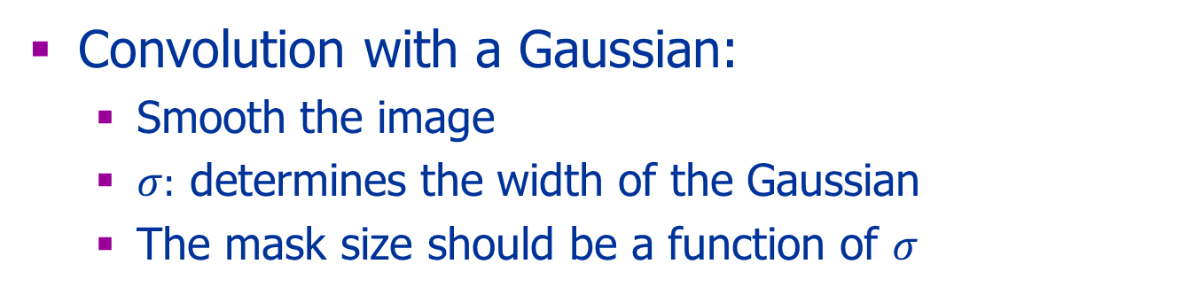
Gaussian Filter
Convolution with a Gaussian:
Smooth the image
$σ:$ determines the width of the Gaussian
The mask size should be a function of $σ$
Notes:
Any idea why we use 1/2pi..?

Slide 5
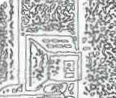
Canny Edge-Detector
Noise smoothing:
Gaussian
Canny Enhancer:
Image gradients
Edge thinning:
Non-maximum suppression
Connected edge contours
Hysteresis threshold

Slide 6
Canny Enhancer
Compute the gradients of an image after the image is smoothed by a Gaussian
For each pixel p= (i,j) output:
Gradient magnitude:

Slide 7
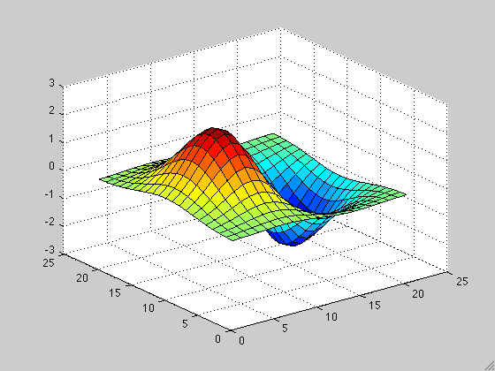
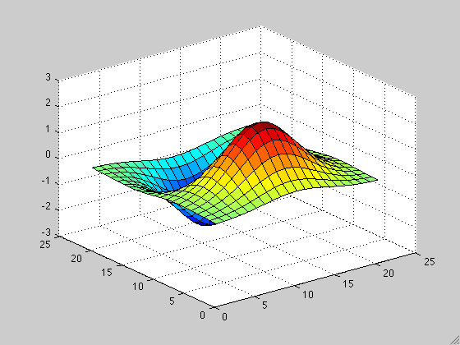
Smoothing & Taking Derivatives
Associativity
Scale

Slide 8
Matlab Tips
Use meshgrid and apply the function to the results:
[y,x]=meshgrid(-500:500,-500:500);
z=x.^2+y.^2; % This will generate a 2D parabola
figure; imshow(z,[])

Slide 9
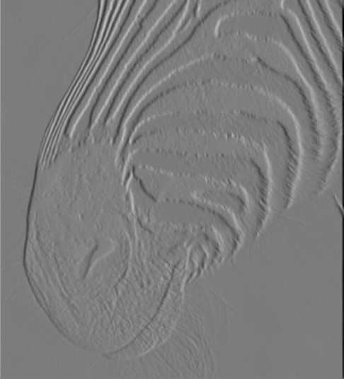
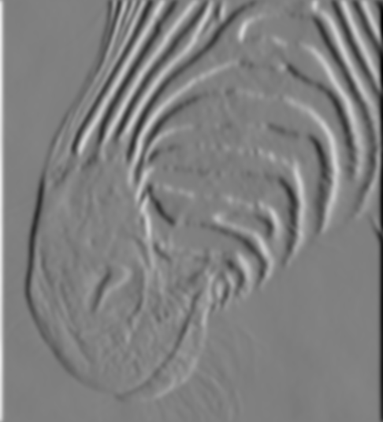
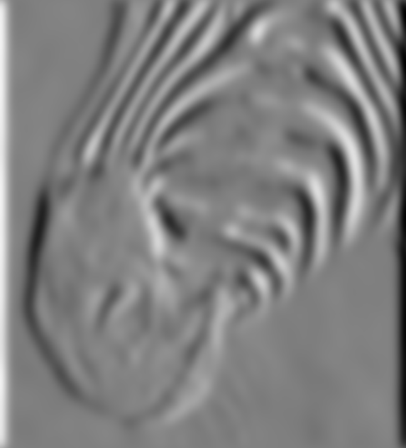
1 pixel
3 pixels
7 pixels
The scale of the smoothing filter affects derivative estimates,
Forsyth, 2002

Slide 10


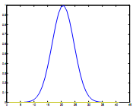
Thinning
Edge Direction
Non-maximum Suppression
A single point along the edge normal
Edge Normal
Edge magnitude
Edge normal

Slide 11
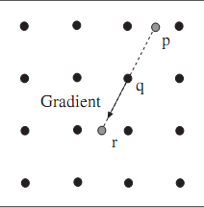
Thinning
Approximates the edge direction of a pixel
E_{o}(p) to be one of: 0º, 45º, 90º, 135^{o.}
Looks at E_{s}(p) of its two neighbors:
If it is the maximum: E_{new_s} (p) = E_{s}(p)
Otherwise: E_{new_s} (p) = 0
r’

Slide 12
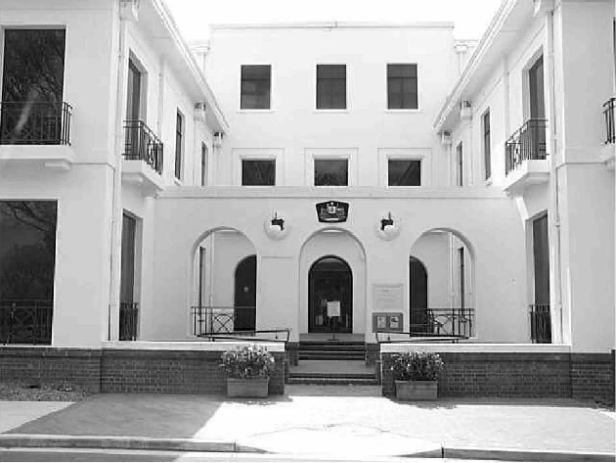
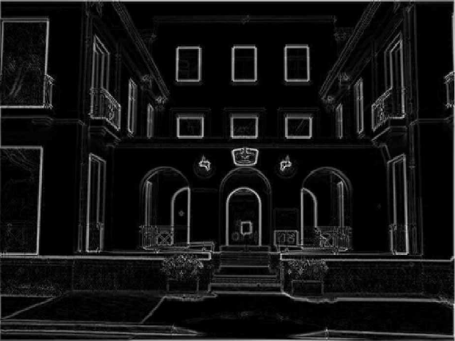
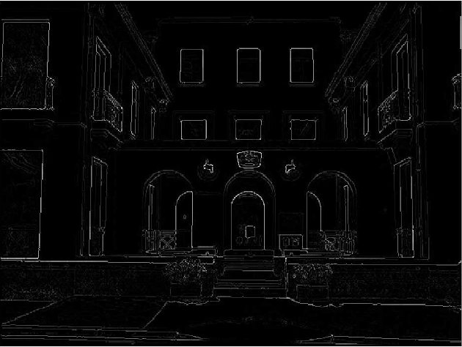
Thinning: Non-Maximum Suppression
courtesy of G. Loy
Non-maxima
suppressed
Original image
Gradient magnitude (canny enhancer)
Slide credit: Christopher Rasmussen

Slide 13
Hysteresis Threshold
Use two thresholds: t_{low} and t_{high}:
Choose an edge point E_{new_s} (p) > t_{high}
Follow a chain of connected edge points such that E_{new_s}(p)> t_{low}
Choosing thresholds:
Too low - can add noise (false positive)
Too high - loose edge points (false negative)

Slide 14
The Parameters
Smoothness, σ
Th_low and Th_high

Slide 15
Summary: Canny Edge-Detector
Compute derivatives of the
Gaussian smoothed image
Canny Enhancer: gradient magnitude
Thinning: Non-maximum suppression
Hysteresis threshold:
Connected edge contours

Slide 16
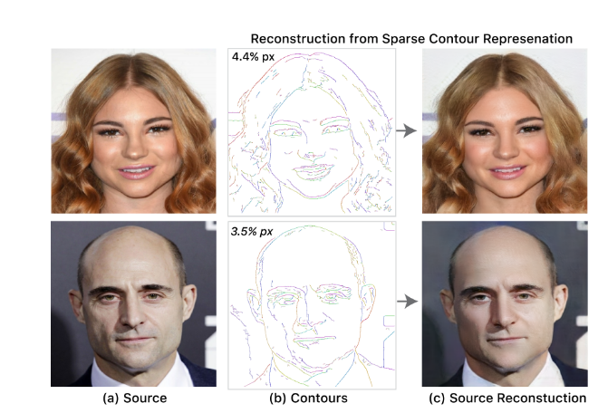
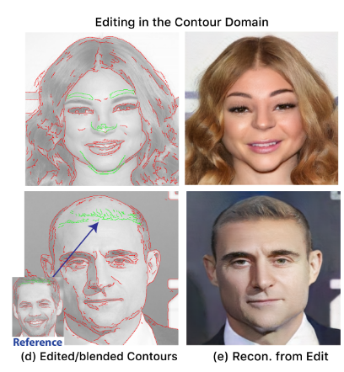
Novel Application
Sparse, Smart Contours to Represent ans manipulate images Dekel et al 2018 proj
video t30

Slide 17
Evaluation
Good detection minimizes:
False negatives, the failure to detect edge pixels
False positives, the detection of a non edge pixels
Good localization:
Edges must be as close as possible to the true edges
Single response constraints:
One point for each true edge point

Slide 18
Other Types of Edges
Step edges
Roof Edges
Line Edges

Slide 19
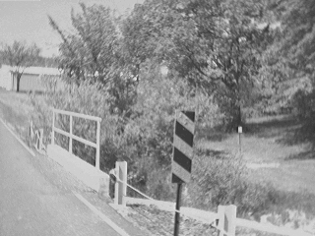
What causes an edge?
Depth discontinuity
Surface orientation discontinuity
Reflectance discontinuity (i.e., change in surface material properties)
Illumination discontinuity (e.g., shadow)
Slide credit: Christopher Rasmussen

Slide 20
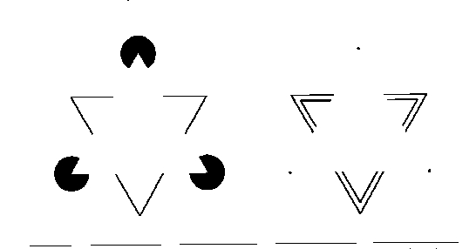
Illusory Contours

Slide 21

Other Edges
Discontinuity in depth
Discontinuity in texture
Discontinuity in motion

Slide 22
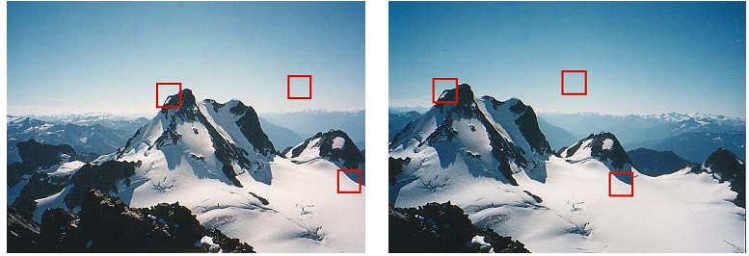


Point Features
Interest point:
Definition
Detection (location)
Descriptor
Matching

Slide 23
Point Features
A corner
Maxima curvature
Bitangent point
Inflection point

Slide 24
Corners

Slide 25
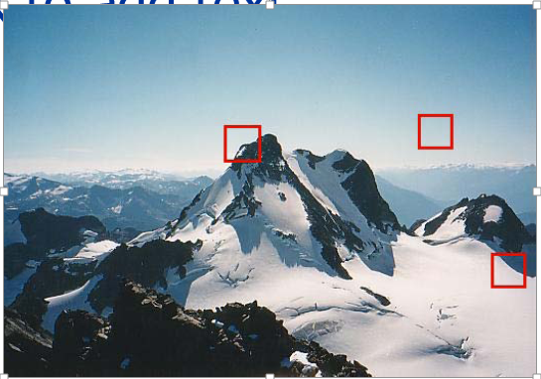
Observation
Shift correlation
No texture
Edge
“corner”

Slide 26
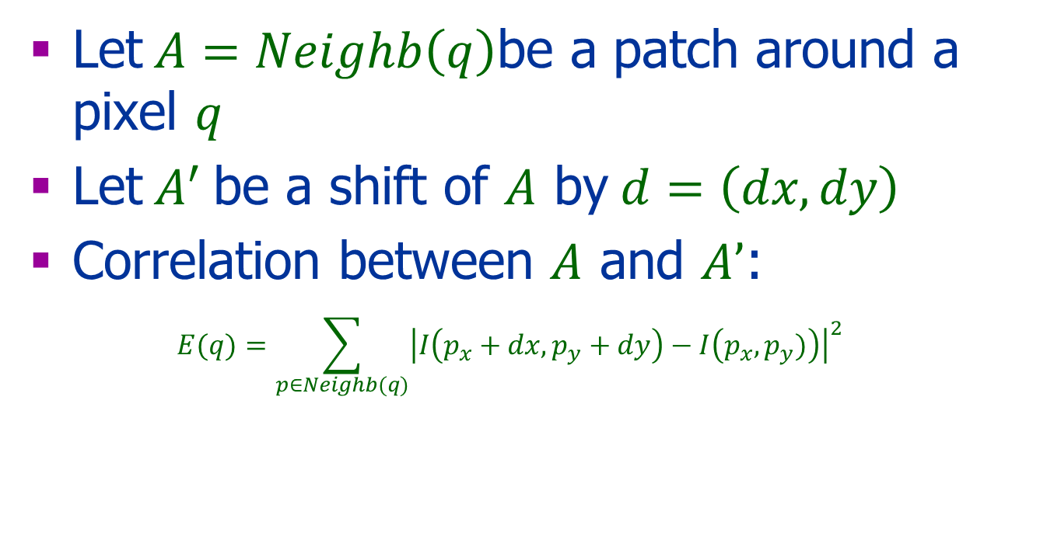
Shift Correlation
Let$A=Neighb\left(q\right)$be a patch around a pixel $q$
Let$A^{′}$ be a shift of $A$ by$d=\left(dx,dy\right)$
Correlation between $A$ and $A’$:
$$E(q)=\sum_{p∈Neighb(q)}{{\left|I\left(p_{x}+dx,p_{y}+dy\right)−I\left(p_{x},p_{y})\right)\right|}^{2}}$$

Slide 27
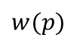
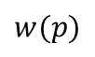
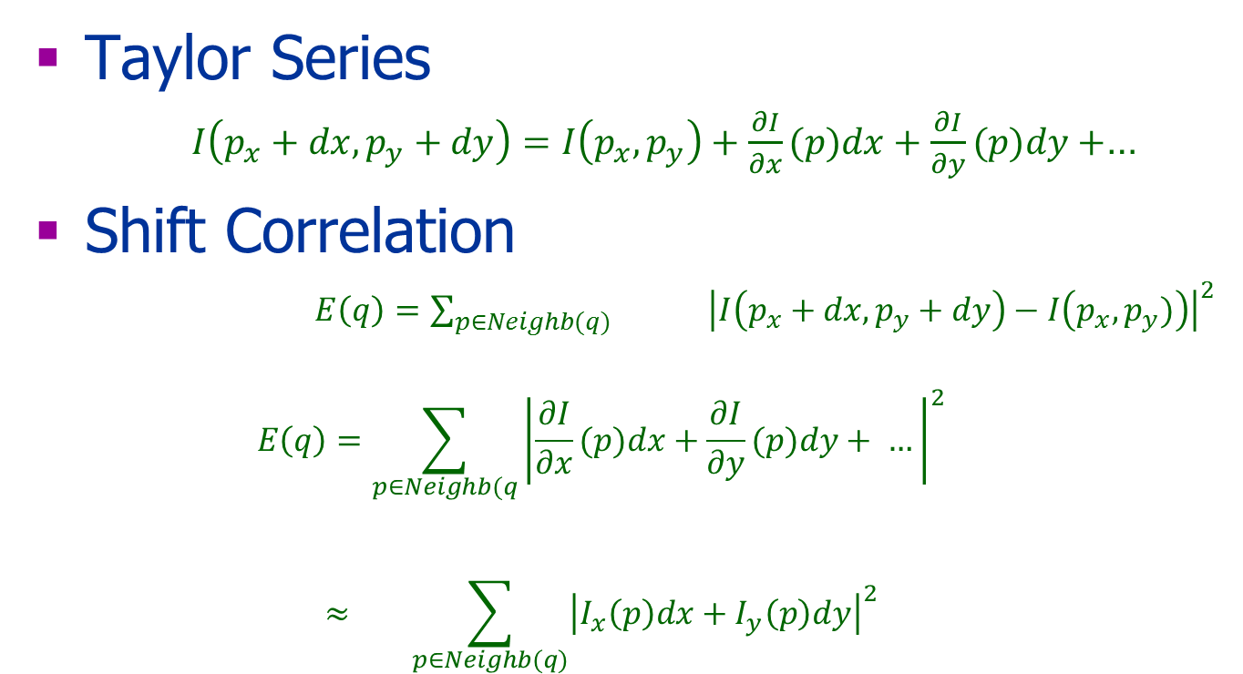
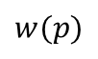
Computing Correlation
Taylor Series
$I\left(p_{x}+dx,p_{y}+dy\right)=I\left(p_{x},p_{y}\right)+\frac{∂I}{∂x}(p)dx+\frac{∂I}{∂y}(p)dy+$…
Shift Correlation
$E\left(q\right)=\sum_{p∈Neighb(q)}{{ \left|I\left(p_{x}+dx,p_{y}+dy\right)−I\left(p_{x},p_{y})\right)\right|}^{2}}$
$$E\left(q\right)=\sum_{p∈Neighb(q}{{\left|\frac{∂I}{∂x}(p)dx+\frac{∂I}{∂y}(p)dy+ …\right|}^{2}}$$
$$≈ \sum_{p∈Neighb(q)}{{\left|I_{x}\left(p\right)dx+I_{y}\left(p\right)dy\right|}^{2}}$$
$$w(p)$$
$$w(p)$$
$$w(p)$$

Slide 28
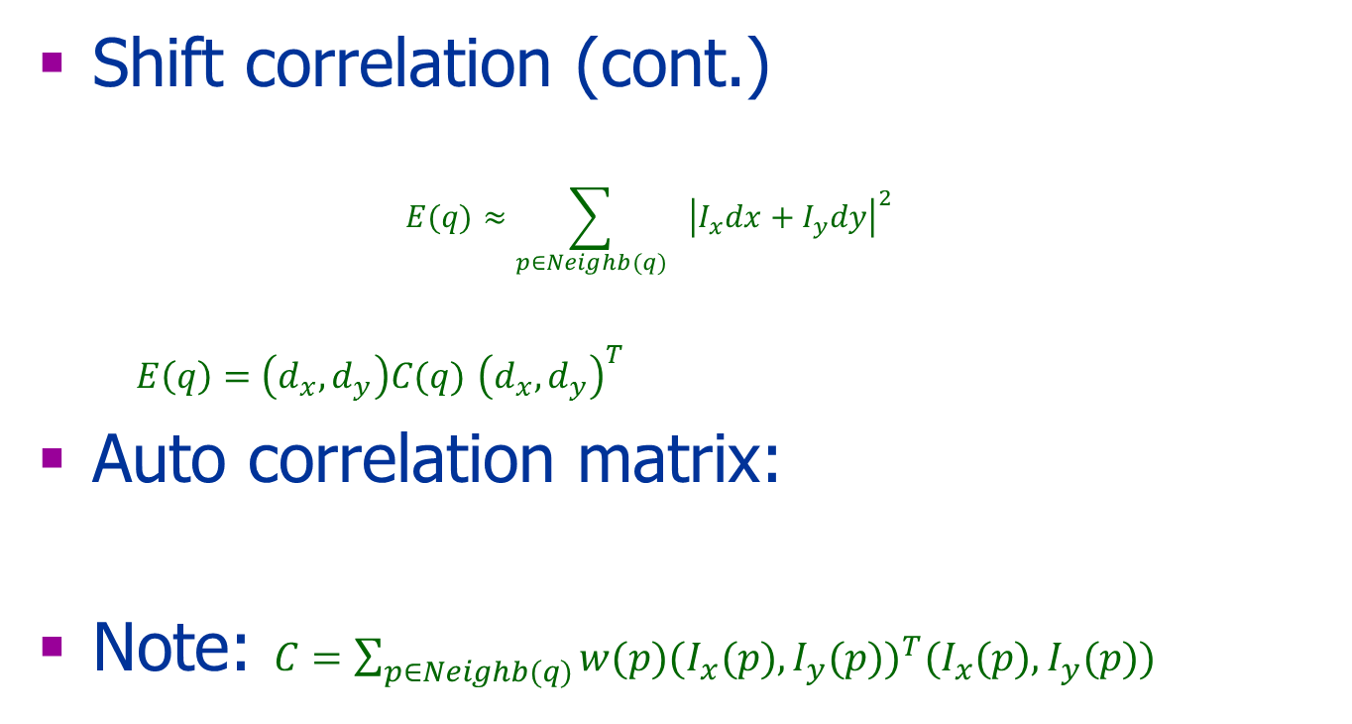
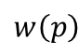
Computing Correlation
Shift correlation (cont.)
$$E(q)≈\sum_{p∈Neighb(q)}{ {\left|I_{x}dx+I_{y}dy\right|}^{2}}$$
$E\left(q\right)=\left(d_{x},d_{y}\right)C(q)$ ${\left(d_{x},d_{y}\right)}^{T}$
Auto correlation matrix:
Note: $C=\sum_{p∈Neighb(q)}{w(p){{(I}_{x}(p),I_{y}(p))}^{T}(I_{x}(p),I_{y}(p)) }$
$w\left(p\right)$

Slide 29
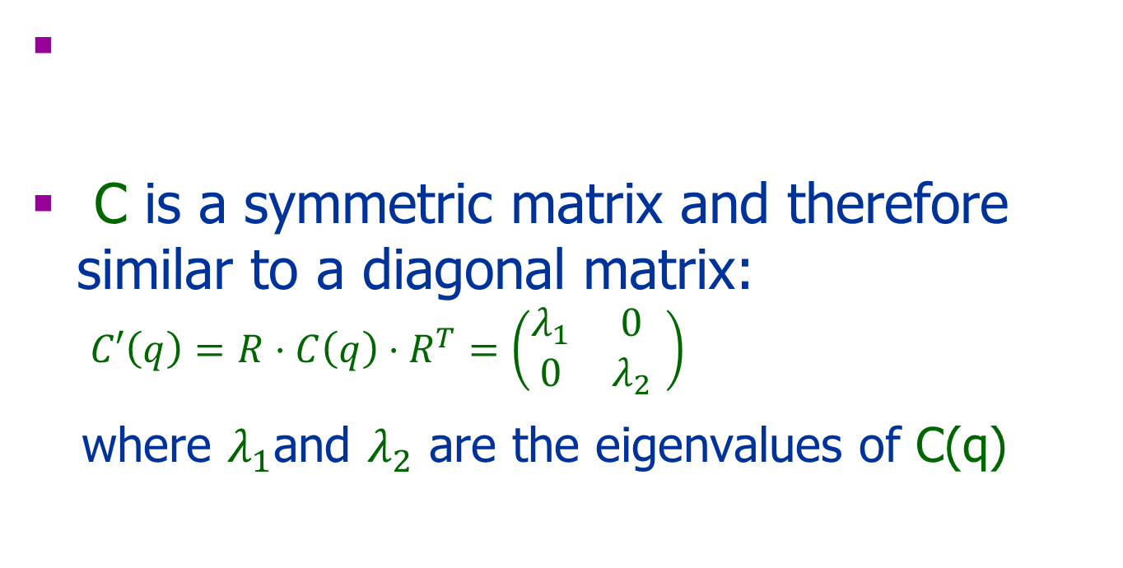
Harris Matrix
C is a symmetric matrix and therefore similar to a diagonal matrix: $C′\left(q\right)=$ $R⋅C\left(q\right)⋅R^{T}=\left(\begin{matrix}λ_{1} & 0 \\ 0 & λ_{2}\end{matrix} \right)$
where $λ_{1}$and $λ_{2}$ are the eigenvalues of C(q)

Slide 30
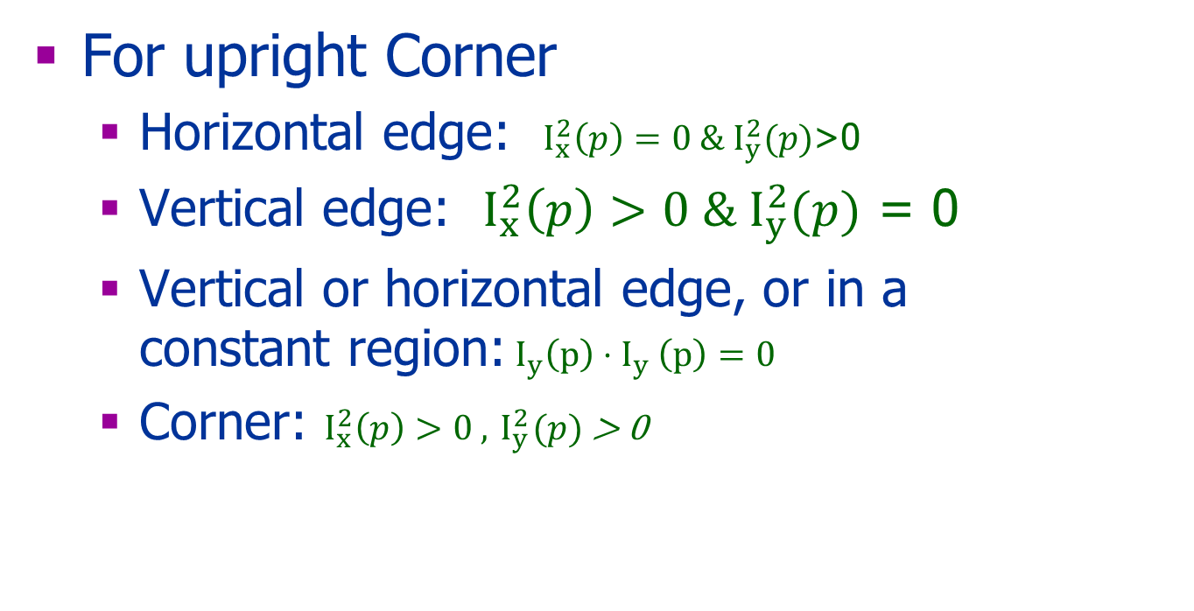
Observations
For upright Corner
Horizontal edge: $I_{x}^{2}\left(p\right)=0 \&{ I}_{y}^{2}(p)$>0
Vertical edge: $I_{x}^{2}\left(p\right)>0 \&{ I}_{y}^{2}(p)$ = 0
Vertical or horizontal edge, or in a constant region:${ I}_{y}^{}\left(p\right){⋅I}_{y}^{}\left(p\right)=0$
Corner: $I_{x}^{2}\left(p\right)>0 ,{ I}_{y}^{2}(p)$ > 0

Slide 31
Edge Direction & Strength
The eigenvectors encode the edge direction
The eigenvalues encode the edge strength

Slide 32
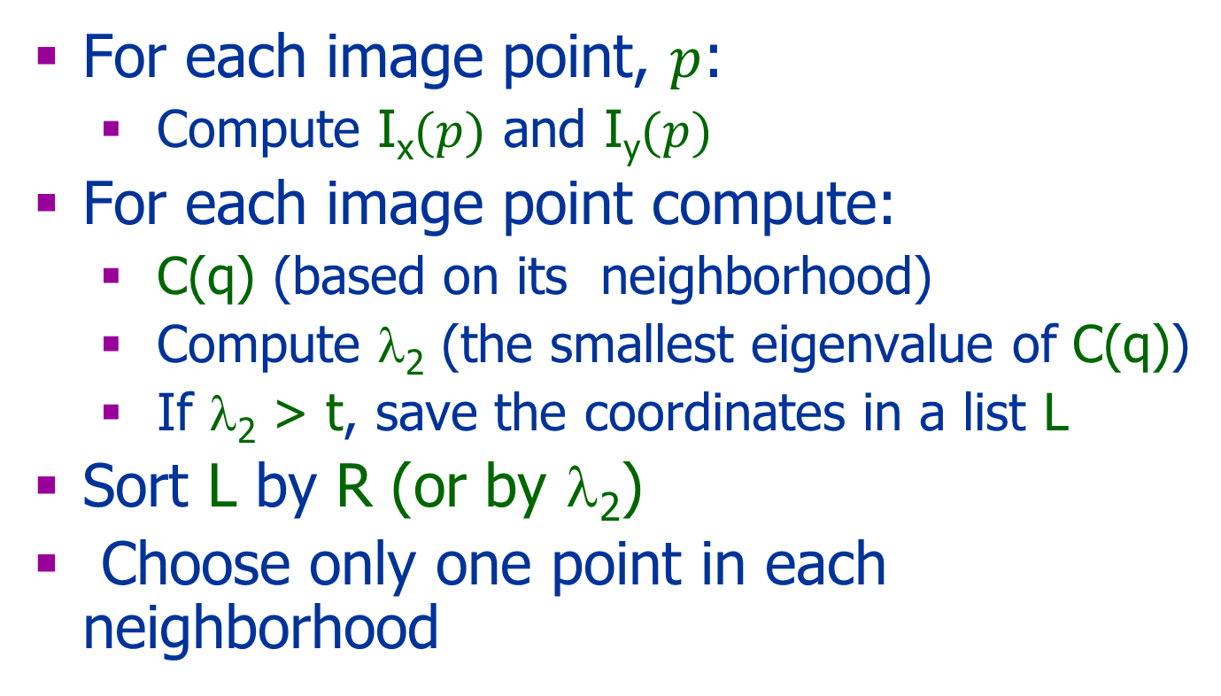
Harris Corner Detector Algorithm
For each image point, $p$:
Compute I_{x}$(p)$ and I_{y}$(p)$
For each image point compute:
C(q) (based on its neighborhood)
Compute λ₂ (the smallest eigenvalue of C(q))
If λ₂ > t, save the coordinates in a list L
Sort L by R (or by λ₂)
Choose only one point in each neighborhood
Compute d= λ₁ λ₂-k(λ1+ λ2)= det(C)-k*Trace(C)²
d

Slide 33

Harris Detector: Workflow

Slide 34

Harris Detector: Workflow
Compute corner response d

Slide 35

Harris Detector: Workflow
Find points with large corner response: d>threshold

Slide 36
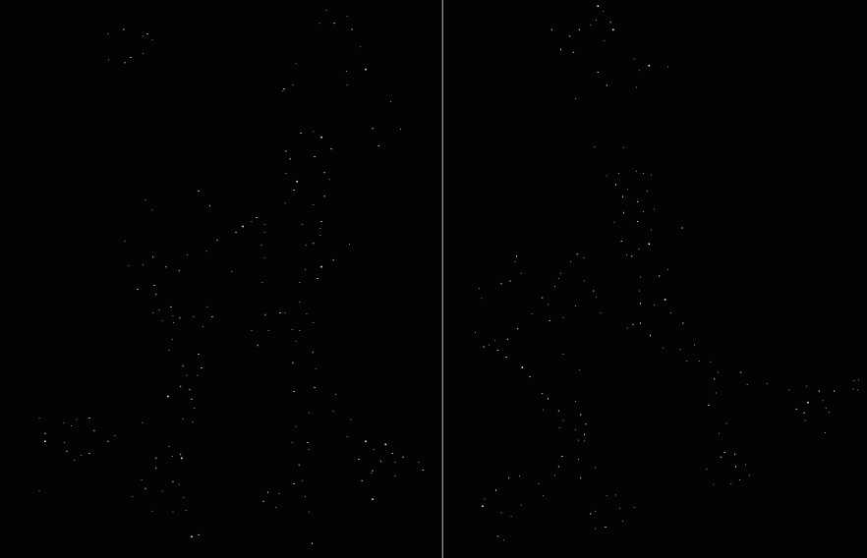
Harris Detector: Workflow
Take only the points of local maxima of d

Slide 37
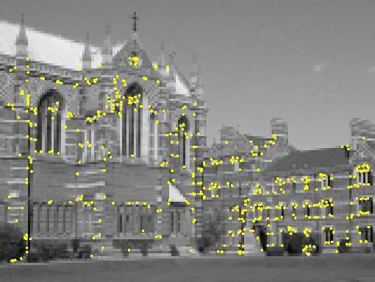
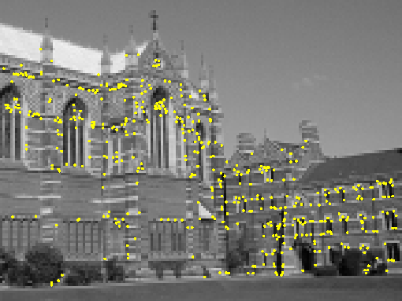
Harris Detector
Interest points extracted with Harris (~ 500 points)

Slide 38
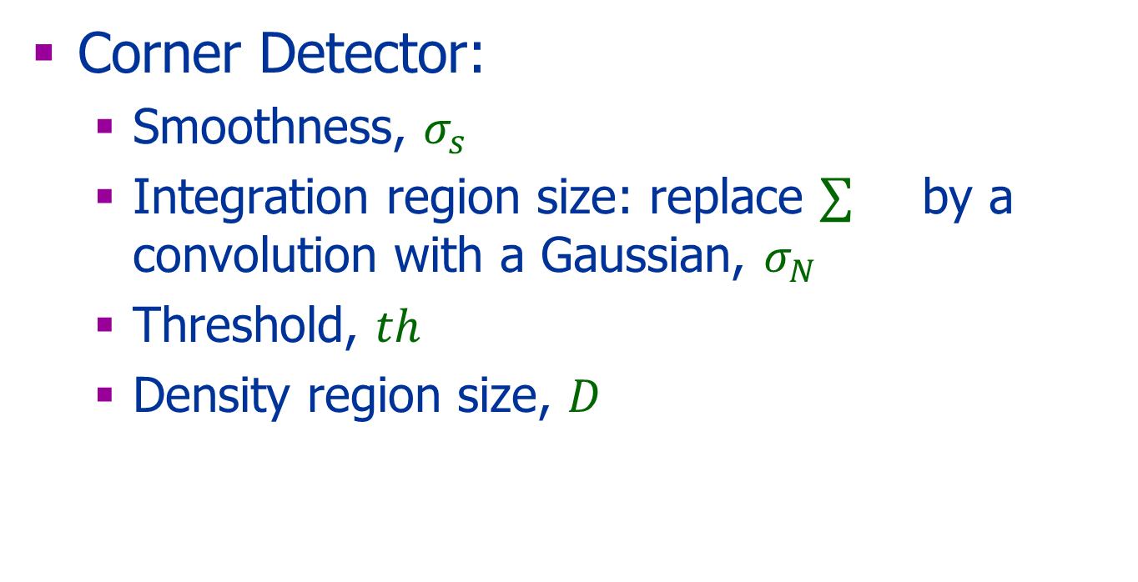
The Parameters
Corner Detector:
Smoothness, $σ_{s}$
Integration region size: replace by a convolution with a Gaussian, $σ_{N}$
Threshold, $th$
Density region size, $D$

Slide 39
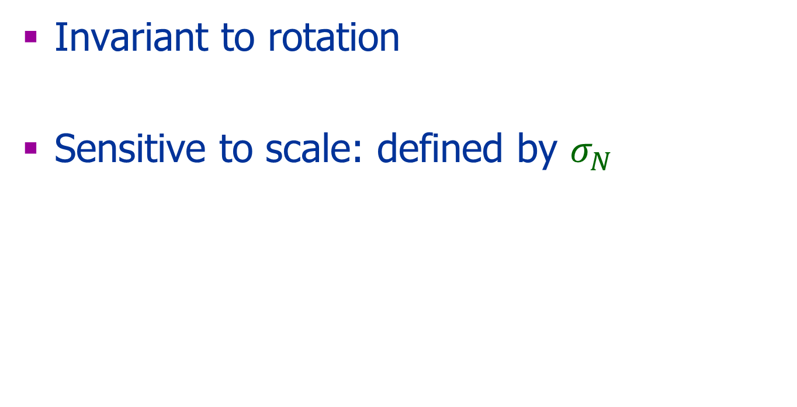
Properties
Invariant to rotation
Sensitive to scale: defined by $σ_{N}$

Slide 40
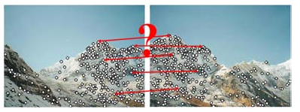
How to Match?
Taken from Szeliski

Slide 41


How to Match?
Use a rich descriptor rather than just the feature location
Detection of interest points (e.g., Harris corners)
Descriptors for each point
?
( )
local descriptor

Slide 42
Features Descriptors

Slide 43
Desired Properties
Discriminative
Efficient to compute
Robust location:
Insensitivity to image variations
2D/3D variations
Camera properties
Illumination

Slide 44
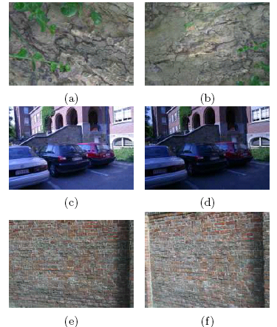
Image Variations
Viewpoint change (graf)
Scale + Rotation (bark)
Blur
Blurring (bikes)
Illumination change (leuven)

Slide 45
2D Image Variations
Rotation
Scale
Similarity
(rotation + uniform scale)
Translation
Affine

Slide 46
Descriptor
Simple option: a patch around the point
Expected problems:
Scale
Orientation
Illumination
..

Slide 47
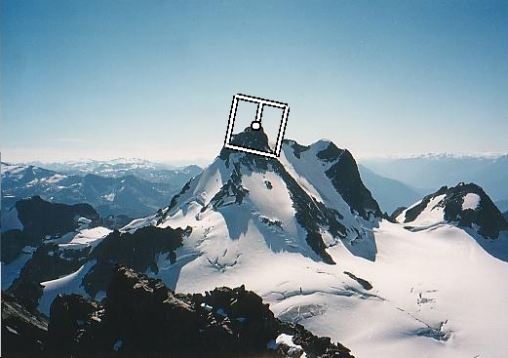
Patch
Harris corner detector is invariant to translation and rotation
The patch can be normalized using:
Corner direction (defined by the eignevectors)
How to define the scale?

Slide 48
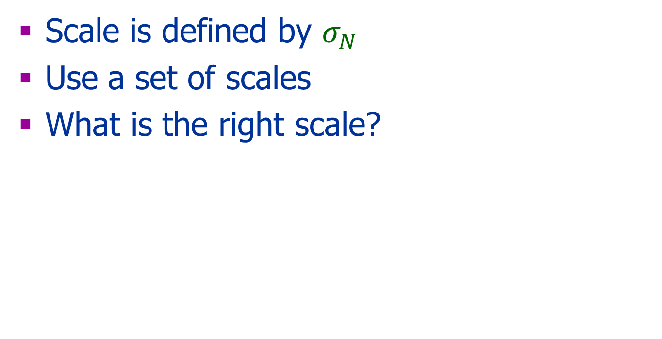
Scale
Scale is defined by $σ_{N}$
Use a set of scales
What is the right scale?

Slide 49
Detections at Multiple Scales

Slide 50
Scale Invariant Detection
Consider regions (e.g. circles) of different sizes around a point
Regions of corresponding sizes will look the same in both images

Slide 51
Scale Invariant Detection
The problem: how do we choose corresponding circles independently in each image?

Slide 52
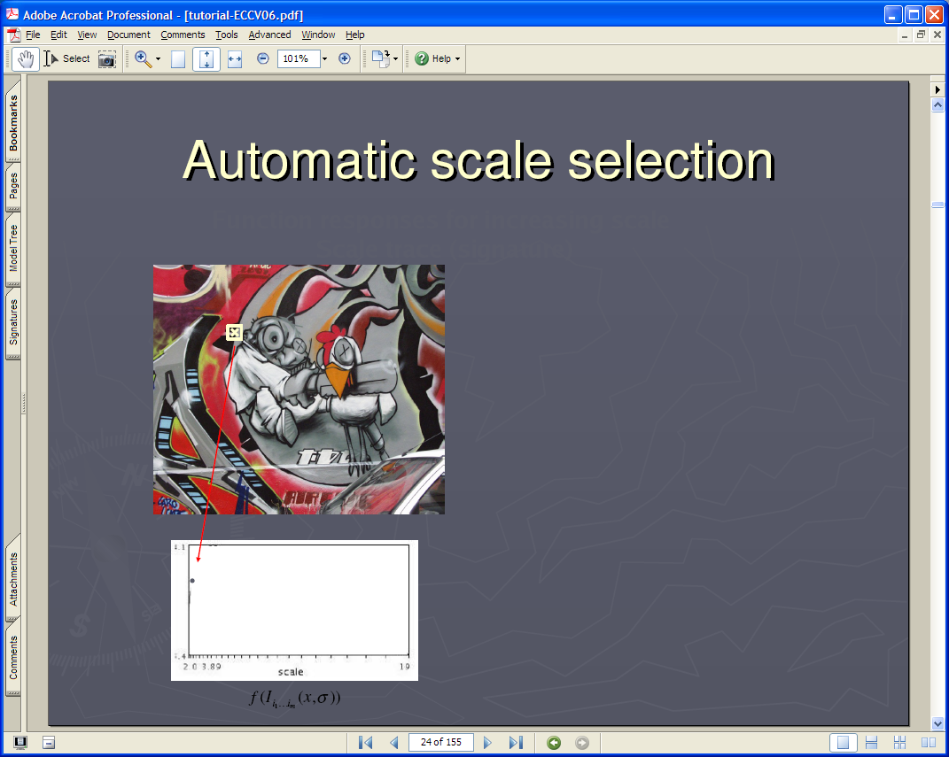
Lindeberg et al, 1996
Lindeberg et al., 1996
Slide from Tinne Tuytelaars
Slide from Tinne Tuytelaars

Slide 53

Slide from Tinne Tuytelaars

Slide 54

Slide from Tinne Tuytelaars

Slide 55

Slide from Tinne Tuytelaars

Slide 56
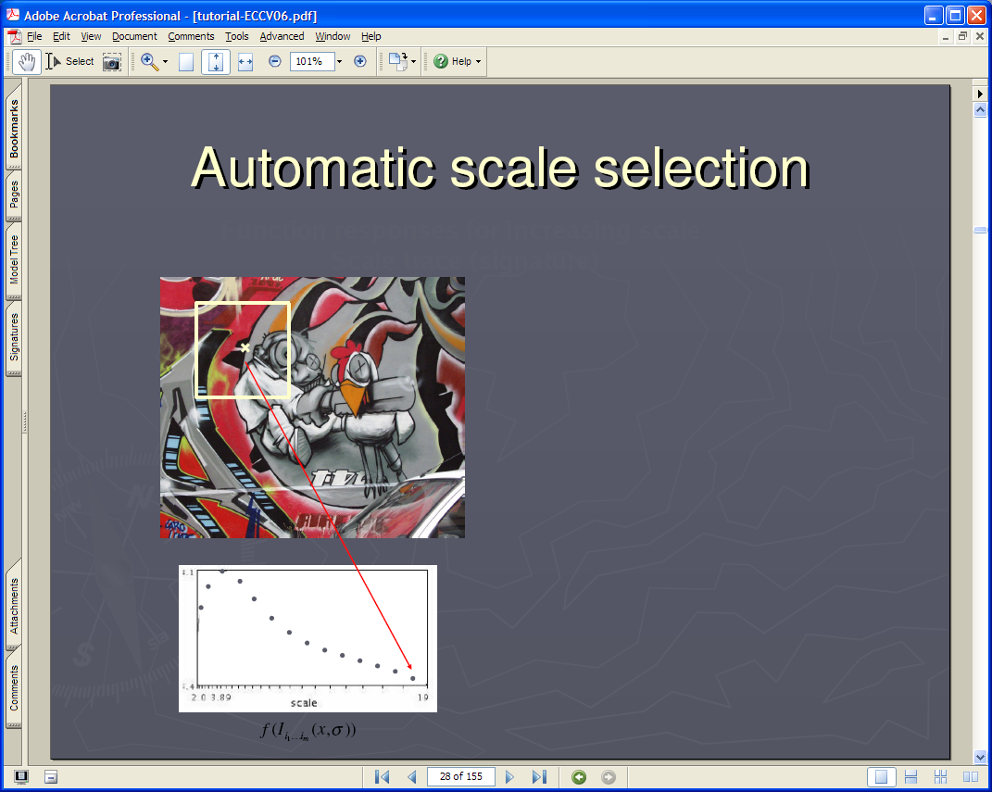
Slide from Tinne Tuytelaars

Slide 57

Slide from Tinne Tuytelaars

Slide 58
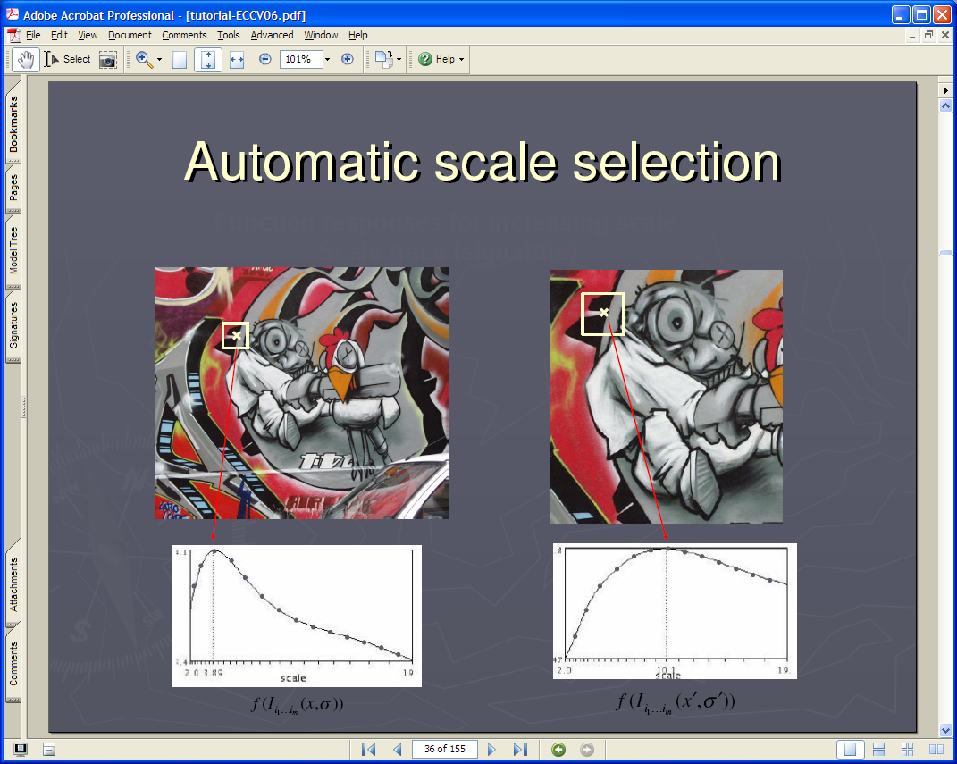
Slide from Tinne Tuytelaars

Slide 59
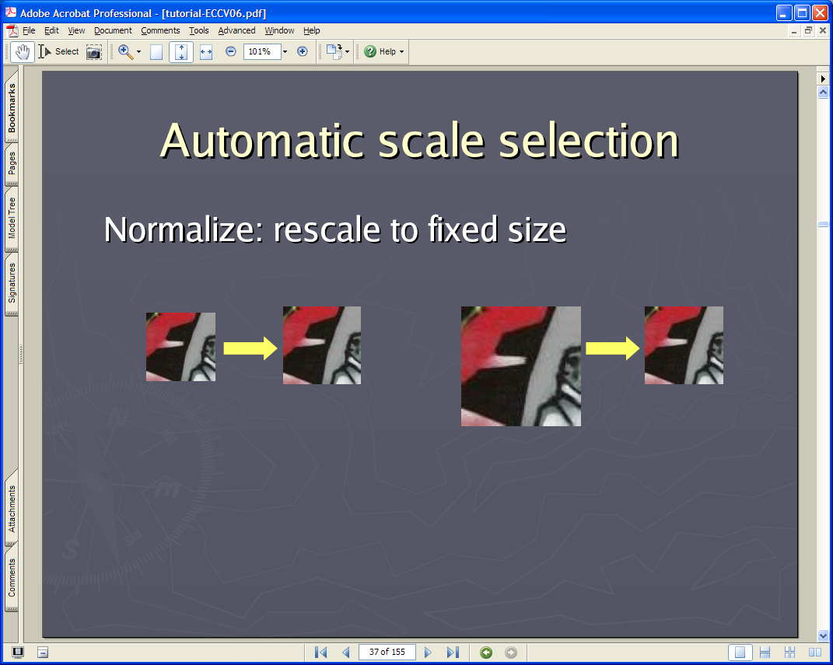
Slide from Tinne Tuytelaars

Slide 60
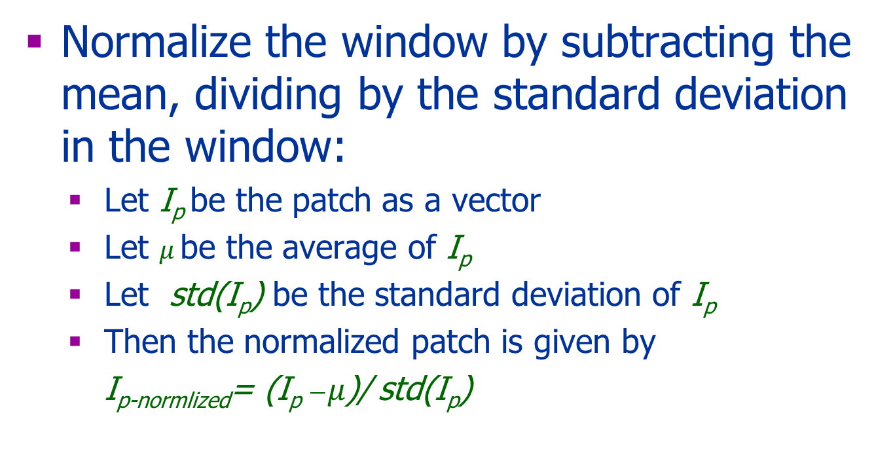

Intensity Normalization
Normalize the window by subtracting the mean, dividing by the standard deviation in the window:
Let I_{p} be the patch as a vector
Let $μ$ be the average of I_{p}
Let std(I_{p}) be the standard deviation of I_{p}
Then the normalized patch is given by
I_{p-normlized}= (I_{p} $−μ$)/ std(I_{p})
$$std\left(X\right)=\sqrt{E{\left(x−μ\right)}^{2}}$$

Slide 61
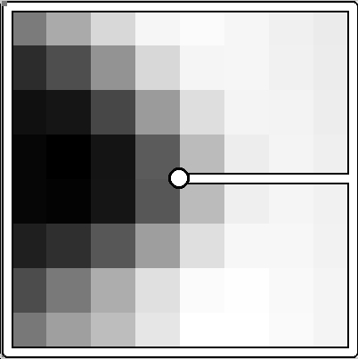
Multiscale Oriented PatcheS descriptor
Take 40x40 square window around detected feature
Scale to 1/5 size (using prefiltering)
Rotate to horizontal
Intensity scaling
40 pixels
8 pixels
Adapted from slide by Matthew Brown

Slide 62
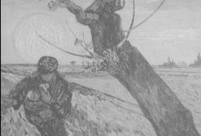
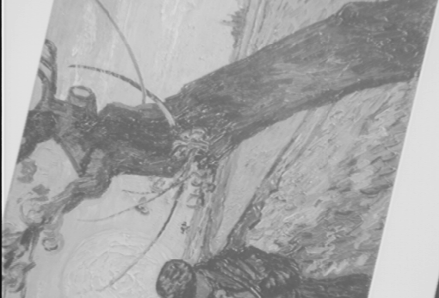
Matching Descriptors
Similarity of descriptors
Semi-local constraints
Global constraints:
Fundamental matrix
Affine transformation
Later on in the course
( )
?
( )
=
Vector comparison

Slide 63
Other Descriptors
What we learned so far is not good enough
Other descriptors:
Local histogram
Local SIFT descriptor (one of the most popular one)

Slide 64
Scale Invariant Feature Transform
Next Class
Take 16x16 square window around detected feature
Compute edge orientation for each pixel
Throw out weak edges
Create histogram of surviving edge orientations
Adapted from slide by David Lowe

Slide 65

SIFT Descriptor
Next Class
16 cells * 8 orientations = 128 dimensional descriptor
0
2π
angle histogram
Adapted from slide by David Lowe

Slide 66
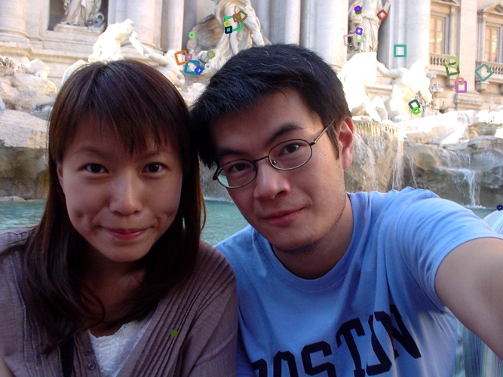

Properties of SIFT
Next Class
Changes in viewpoint: Up to about 60 degree out of plane rotation
Significant changes in illumination
Fast and efficient (?)—can run in real time
Adapted from Steve Seitz

Slide 67


Eliminating Bad Matches
Throw out features with distance > th
What is the right threshold?
50
true match
75
200
false match
feature distance
Adapted from Steve Seitz

Slide 68

Feature Distance
Sum of differences, and threshold
Problem: ambiguous matching
f₁
f₂
I₁
I₂
Adapted from Seitz (also next slide)

Slide 69
Nearest Neighbor Distance Ratio
f₂ best match to f₁
f₂’ is 2nd best match to f₁
Search for low d(f₁, f₂) / d(f₁, f₂’)
Gives large values (~1) for ambiguous matches
f₂
f₂'
f₁

Slide 70


Global Constraints (later on in the course)
Robust estimation of the fundamental matrix
99 inliers
89 outliers

Slide 71
Performance Evaluation
Next Class
Compare parameters
Compare different methods

Slide 72
True/false positives
Next Class
The distance threshold affects performance
True positives = # of detected matches that are correct
Suppose we want to maximize these—how to choose threshold?
False positives = # of detected matches that are incorrect
Suppose we want to minimize these—how to choose threshold?
true match
200
false match
Adapted from Steve Seitz

Slide 73
Evaluating the Matching
Next Class
1
the matcher correctly found a match
0.7
true positive rate
# true positives matched
# true positives
features that really do have a match
0
1
false positive rate
0.1
the matcher said yes when the right answer was no
# false positives matched
# true negatives
features that really don’t have a match
Adapted from Steve Seitz

Slide 74

General Terms
Next Class

Slide 75
ROC Curve
Next Class
Generated by counting # correct/incorrect matches, for different thresholds
Want to maximize area
under the curve (AUC)
Used for comparing
different methods
For more info:
http://en.wikipedia.org/wiki/Receiver_operating_characteristic
1
0.7
ROC curve
true positive rate
# false positives matched
# true negatives
0
1
false positive rate
0.1
Adapted from Steve Seitz

Slide 76


More on feature detection/description
Next Class

Slide 77





Performance Evaluation
Next Class
Scale + Rotation (bark)
Viewpoint change (wall)
Viewpoint change (graf)
Blurring (bikes)
Illumination change (leuven)

Slide 78
Other Descriptors
Next Class
Other descriptors:
Local histogram
Local SIFT descriptor (one of the most popular one)
Many more : see list in Szeliski book and latest conferences
Use deep learning – later in the course

Slide 79
Lots of Applications
Next Class
Features are used for:
Image alignment (e.g., mosaics)
3D reconstruction
Motion tracking
Object recognition
Indexing and database retrieval
Robot navigation
… others

Slide 80
Bibliography
Forsyth & Ponce, chapter 8
A computational approach to edge detection, Canny, Readings in computer vision: issues, problems, principles, and paradigms, 1987
A COMBINED CORNER AND EDGE DETECTOR, Harris & Stephens, Alvey Vision Conference, 1988
Additional reading for a broader picture: Szeliski, chapter 4
SIFT

